Slide 1
DD Games

Slide 2
Meet the team
Team Leader/Programmer: Kieran Jack
Design/Production: Andrew Fullarton
Design: Bryan Barbour
Artist: Hollie Girolami
Artist: Maria Hernando
Audio Designer: Thomas Allison
Programmer: Thomas Moynihan

Slide 3
Our Purpose
485,000 tourists visited Dundee in 2015
Expected 3,000,000 Tourists will be visiting Dundee from 2012-2025
We want to show off the city and make these tourists come back again & again
There are options currently but none of them are quite right
Old getting Lost in the new
We want to show off Dundee through games

Slide 4
What If…
You were able to see the old Dundee in the new Dundee way
No need for leaflets
No need in a Tour Guide
Tour Guide in your pocket

Slide 5
The current best option
We went on one of your current Heritage Walks;
Generic & Outdated
Unengaging
No guide
These Heritage Walks NEED to be updated

Slide 6
The next big thing
Dundee is a playful city and it needs something that emulates that
Fits all audiences – Something for everyone
City of Design
We want to create a interactive Tour for Dundee’s Heritage to honour Dundee’s past with it’s present and future

Slide 7
Concept
Showcase Dundee’s heritage through a tour based app using mini games inspired by locations around Dundee
Target audience would be tourists
Designed for mobile meaning it would be highly accessible

Slide 8
The Game
Take the player on a tour of Dundee. Each tour would have it’s own narrative running through providing information of landmarks.
The player would engage in mini games at each location allowing them to progress further in the story of and the tour
Puzzle AR
See Dundee in the game and Real Life

Slide 9
Audio/Visual Concept
Moodboard

Slide 10
Story
Architect assistant getting inspiration from Dundee
Detective finding missing person
Pandora’s box exploring for clues
Treasure hunt
More engaging than current walking around

Slide 11
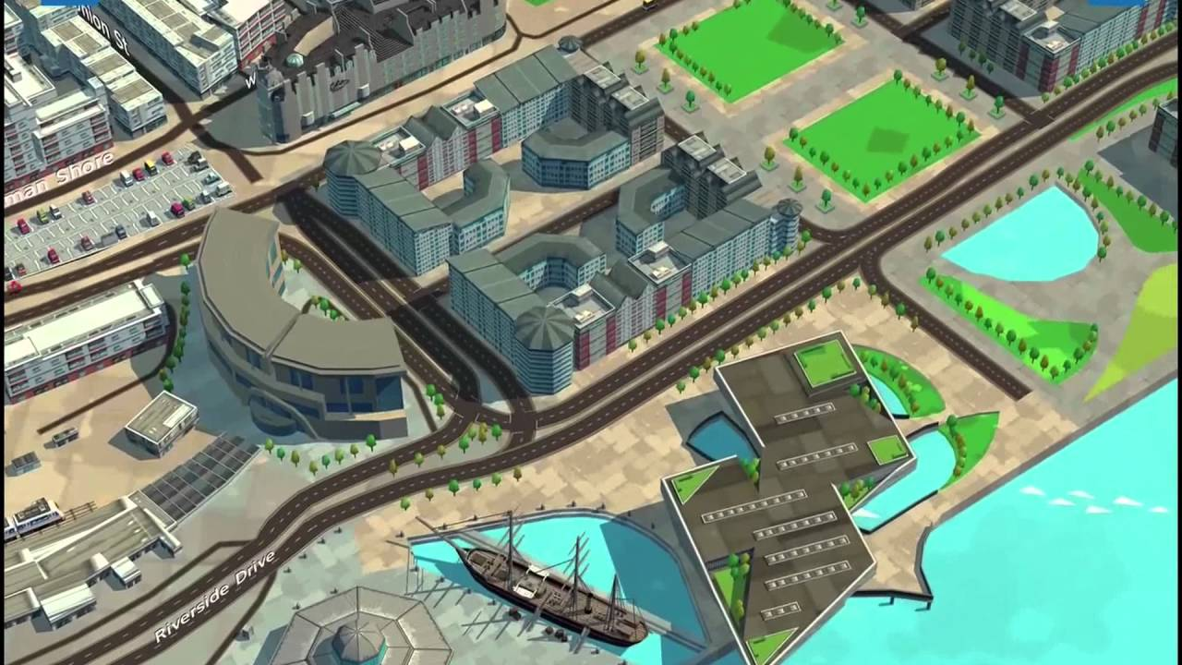
EeGeo
3D Maps platform
Dundee based
Stunning visuals

Slide 12
Inspiration
Pokémon Go
Professor Layton Series
Big City Adventure
Other
Heritage Walks

Slide 13
Deliverables
Prototype
Documentation
Trailer/Gameplay
Promotional Materials

Slide 14
Questions?

Slide 16
Other Options
Tour guide with optional mini games
Gamified walk

